Slide 1
Introducing….
Digital Invoicing Solution
From Tally to Tally
for GIONEE Retailers

Slide 2
Solutions for Retailers
Digital Invoice
for Automated
Feeding into Tally
Access and Share Statement of Account
Invoice in HTML format on Smart Phone

Slide 3
Key Advantages of Combined Solution Offering
Enables Collaborative Accounting
Lowers down cost of managing Accounts & Inventory
Improving Speed of information and data exchange
Accuracy in information capturing – Less Human Errors

Slide 4
Incoming Digital Invoice from RD for automated Feeding into
Creates new mobile models / stock item masters in Tally, if not exists
Automatic insertion of IMEI in Description or in Batch No as per your present practices
Enables mapping of stock items, expenses ledgers, taxes ledgers for every supplier
Displays pre-mapped stock items and others for future digital invoices from same supplier
Choice to post immediately or after relevant approvals
Modifies the existing invoice on posting of revised digital invoices
Benefits
Faster and accurate entry in books of Accounts.
Ensures accuracy in Inventory Management
No Tally knowledge requires and hence business owners can approve invoices and will be posted into Tally automatically
No more interaction / follow up to get invoices to complete your accounting

Slide 5
Access and Share Ledger Accounts From one Tally Company to Another
Easily request for Statement of Accounts from your Connected Parties
Permission based access
Export to Excel for easy reconciliation
Benefits
Easily reconcile your ledgers as per the statement of Accounts.
Faster reconciliation leads to faster receipts of payments.
No need to be dependent on Accountant for access to Statements.

Slide 6
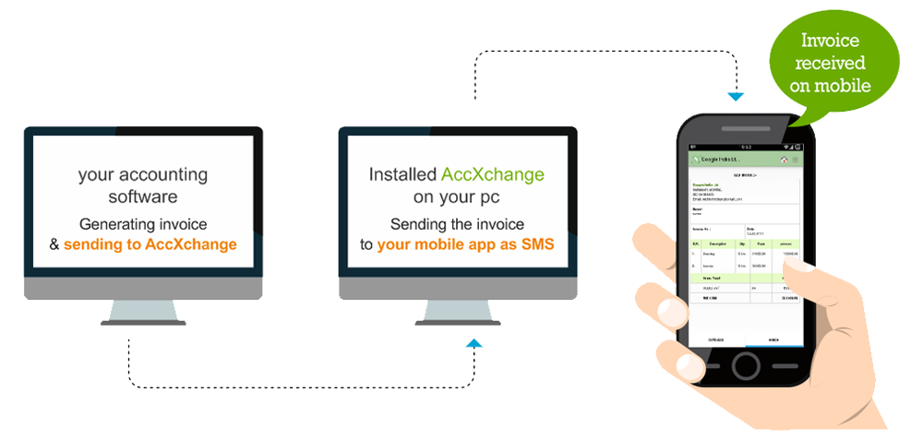
Instant Invoice
on Smart Phone
Receive HTML copy of Invoices generated by Distributor on your Android/iOS phone
No need to view mail for new Invoices generated
Benefits
No need to ask your accountant regarding invoice received
Quick receipt of Invoices leads to Quicker Decision of Sales returns, if requires
Share Invoices instantly with your Partner/Colleagues/Accountants etc.

Slide 7
Screen Show Posting of Incoming Digital Invoice from RD
Books of Google India Ltd
Assuming Supplier and Buyer is already connected

Slide 8
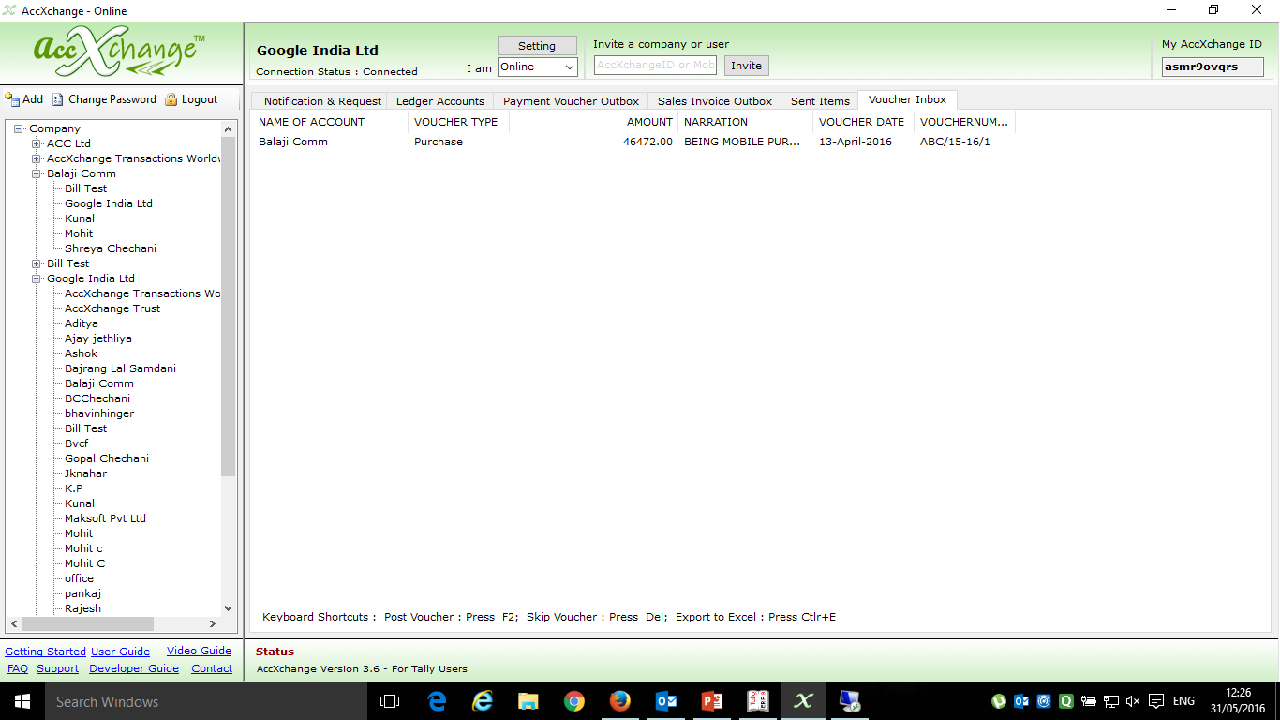
Sales Entry is received from Balaji Comm as Purchase Voucher in Google India Ltd in Voucher Inbox Tab

Slide 9
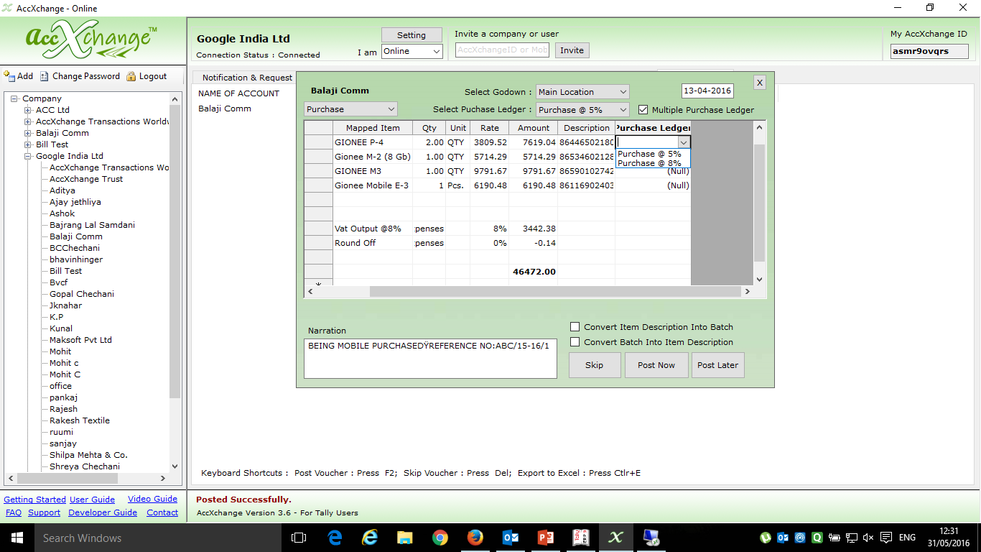
Selecting Item wise Purchase Ledger for user who maintain Item wise Purchase Ledger for Multi Taxation Purpose
Selecting Godown
Selecting Voucher Type Purchase or Purchase Order
Selecting Purchase Ledger if single Common Purchase Ledger is maintained
One time Mapping of Stock Items
One time of input VAT ledger
Converting IMEI from Description to Batch
Converting IMEI Batches to Description
Verifying Entry received from Balaji Comm before posting it in Tally in the books of Google India Ltd

Slide 10
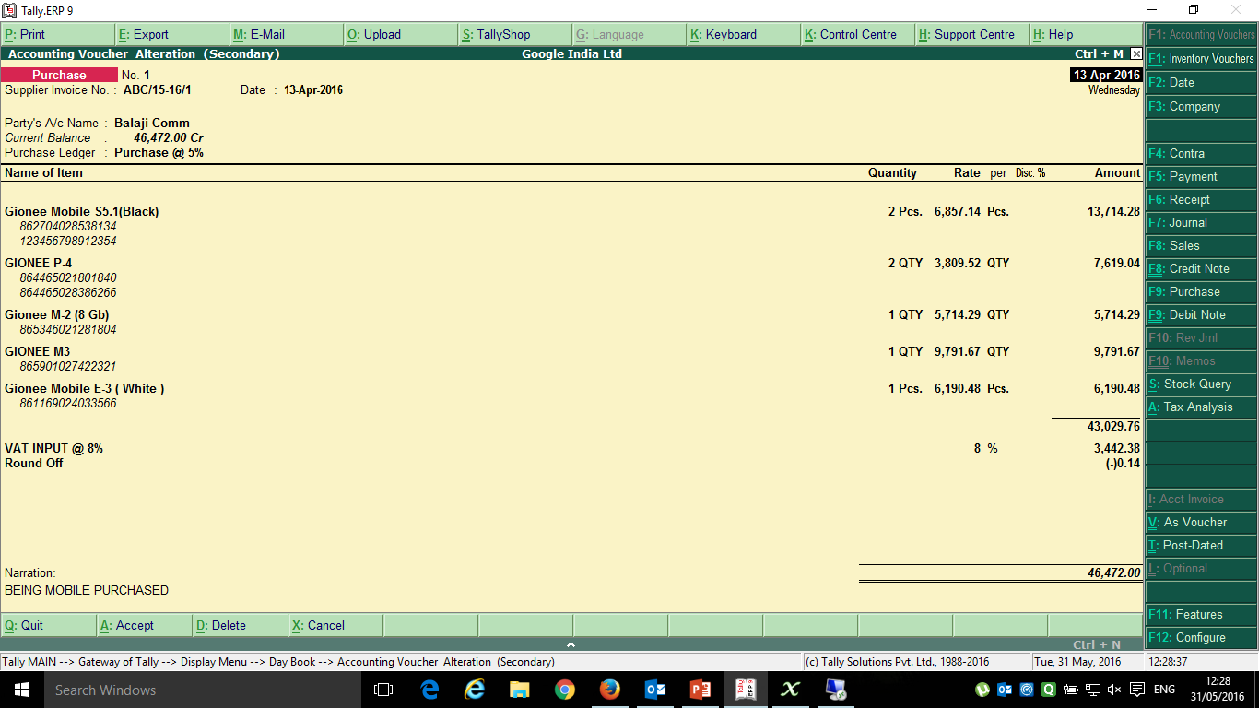
Purchase Entry Successfully Posted in Tally in the Books of Google India Ltd through AccXchange

Slide 11
Screen Show Receiving Digital Invoice from RD on Smart Phone
Books of Google India Ltd
Assuming Supplier and Buyer is already connected through Mobile App

Slide 12
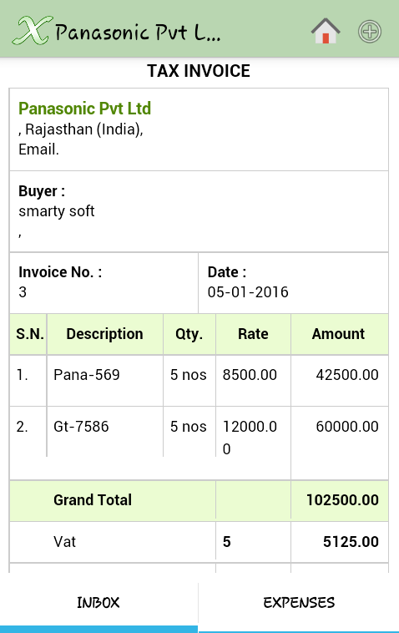
Receive Invoice Digitally on Smartphone.

Slide 13
Thank You
Gopal Chechani
AccXchange Transactions Worldwide Pvt Ltd
Gopal.Chechani@accxchange.in , www.AccXchange.in
Mobile: +91-8875627160

