Slide 1
Introducing….
Mobile IMEI Update Solution
From Tally to Zed Sales- Bill by Bill
for GIONEE Regional Distributors

Slide 2
Solutions for Regional Distributors
Bill by Bill IMEI update from
Tally to Zed Sales
Digital Invoice
for Automated
Feeding into Tally
Access and Share Statement of Account
Invoice in HTML format on Smart Phone

Slide 3
Key Advantages of Combined Solution Offering
Simplifies Zed Sales Portal Update
Enables Collaborative Accounting
Lowers down cost of managing Accounts & Inventory
Improving Speed of information and data exchange
Accuracy in information capturing – Less Human Errors

Slide 4
Challenges With Excel based IMEI upload
Need to prepare Excel Sheet with accurate information
Hunt for Model no for every Mobile IMEI
Multiple efforts to upload on mismatch of certain IMEI
Zed Sales not being updated by ND, even after physical despatch of goods

Slide 5
Bill by Bill IMI update from Tally to Zed Sales.
For both Sales and Sales Return Transactions
Invoice wise pending IMEI Report
Display status of specific IMEI No. or multiple IMEI No.
Check the IMEI No. is in stock of which Distributor/Retailer.
No need to remember SKU code of specific Model.
Upcoming Feature List of Pending Acknowledgement in Zed Sales
Benefits
No more creation of Excel Sheets
Ensure timely and accurate upload
Saves your valuable time

Slide 6
Incoming Digital Invoice from ND for automated Feeding into
Creates new mobile models / stock item masters in Tally, if not exists
Automatic insertion of IMEI in Description or in Batch No as per your present practices
Enables mapping of stock items, expenses ledgers, taxes ledgers for every supplier
Displays pre-mapped stock items and others for future digital invoices from same supplier
Choice to post immediately or after relevant approvals
Modifies the existing invoice on posting of revised digital invoices
Benefits
Faster and accurate entry in books of Accounts.
Ensures accuracy in Inventory Management
No Tally knowledge requires and hence business owners can approve invoices and will be posted into Tally automatically
No more interaction / follow up to get invoices to complete your accounting

Slide 7
Outgoing Digital Invoice for Automated Feeding in Dealer’s/Retailer
Build a list of digital invoices to be send from connected Tally Company
Sends digital invoices one by one after review or set auto sending to identified customers
Facilitates to stop back of auto sending invoices
Benefits
Helps customers accounts reconciled
Speed up realization of payments
Ensures accurate accounting treatment in your customers books
Happy customers because of ease of accounting for them

Slide 8
Access and Share Ledger Accounts From one Tally Company to Another
Easily request for Statement of Accounts from your Connected Parties
Permission based access
Export to Excel for easy reconciliation
Benefits
Easily reconcile your ledgers as per the statement of Accounts.
Faster reconciliation leads to faster receipts of payments.
No need to be dependent on Accountant for access to Statements.

Slide 9
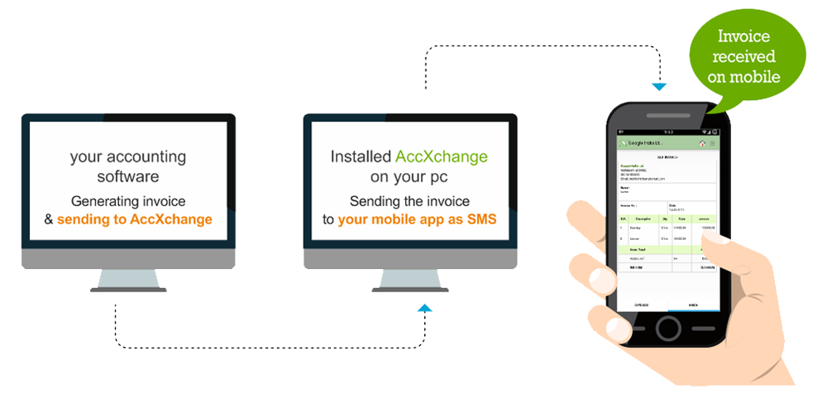
Instant Invoice
on Smart Phone
Receive HTML copy of Invoices generated by Distributor on your Android/iOS phone
No need to view mail for new Invoices generated
Benefits
No need to ask your accountant regarding invoice received
Quick receipt of Invoices leads to Quicker Decision of Sales returns, if requires
Share Invoices instantly with your Partner/Colleagues/Accountants etc.

Slide 10
Screen Show IMEI Numbers update to Zed Sales
Books of Balaji Comm

Slide 11
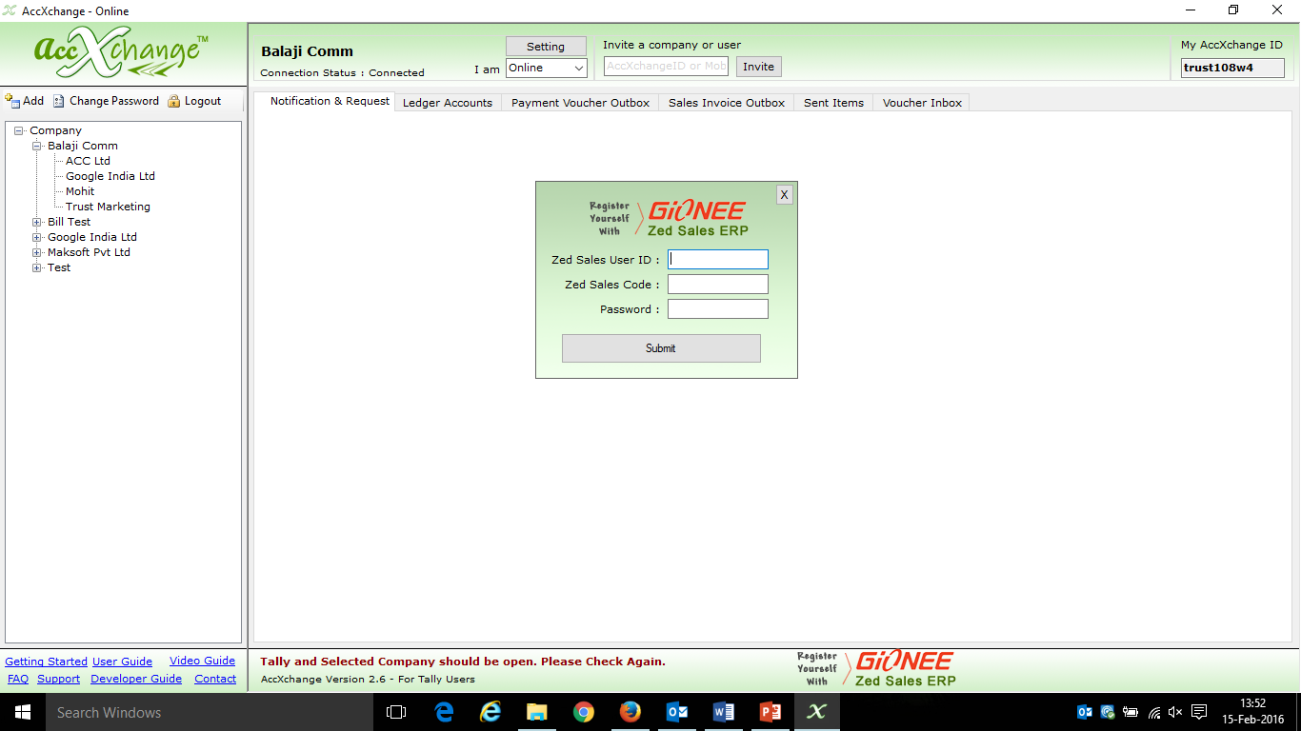
One Time Registration with Zed Sales User Id & Zed Sales Code(Distributor Code)

Slide 12
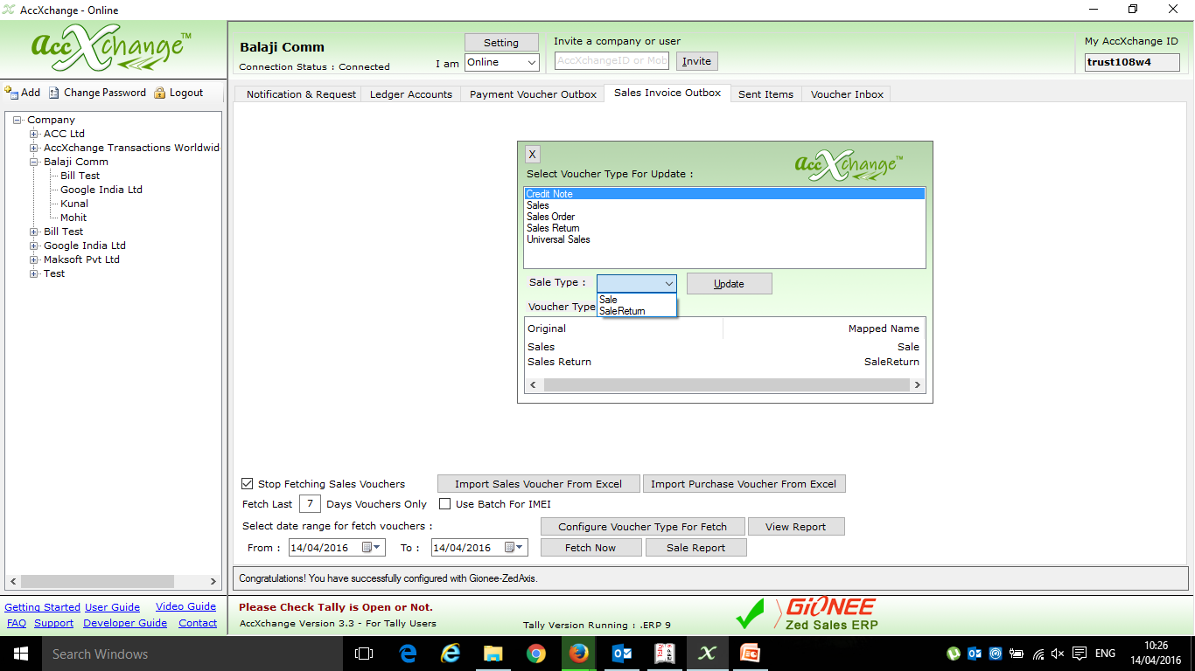
Configuring Voucher types for Sales and Sales

Slide 13
No change in practices to create Sales Invoice
Just Create a Sales Invoice with Following details
Party Name.
Mobile Model No Sold.
IMEI no of Mobiles in either Description or in Batches.
Inputting Other charges and appropriate Taxes.

Slide 14
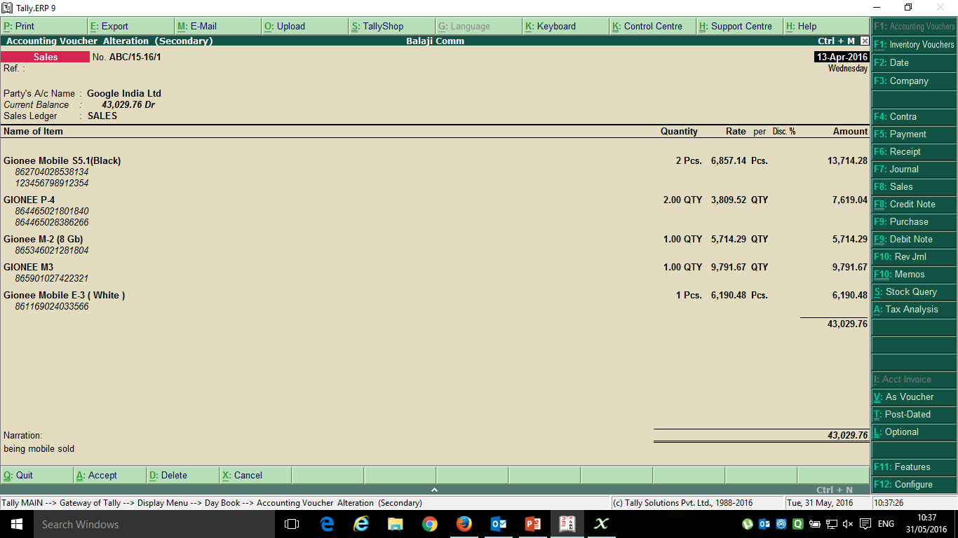
Sales Invoice to sell different models of Gionee Mobiles to Google India Ltd having different IMEI no

Slide 15
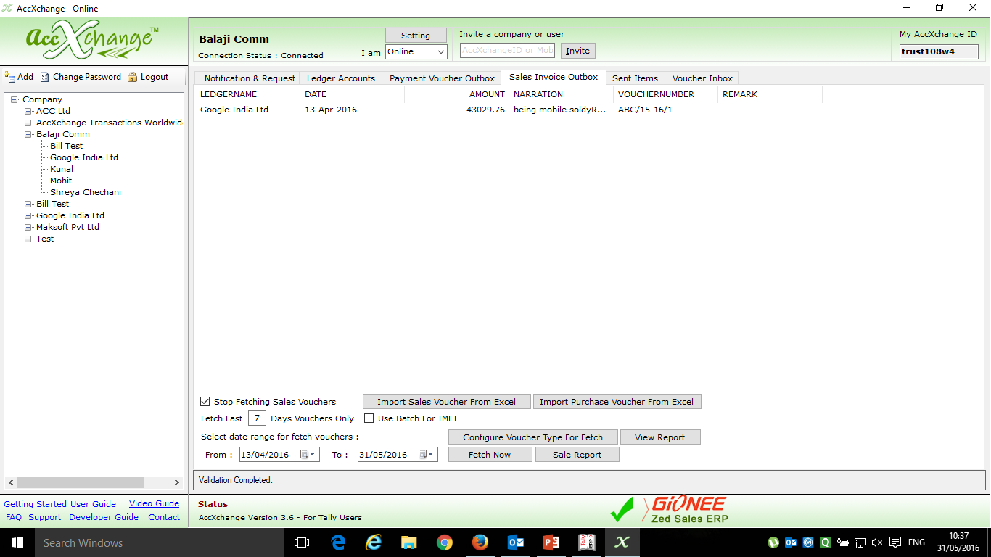
List of Outgoing Digital Invoices to be updated in Zed Sales CRM

Slide 16
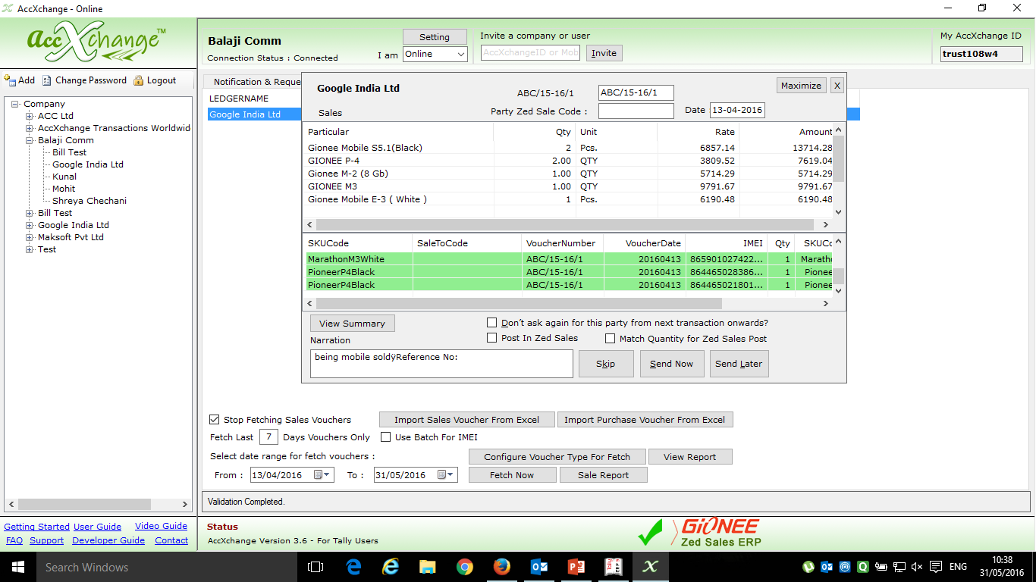
Highlighted IMEI in green color are updated in Zed Sales as they are of Gionee Mobile.
The IMEI numbers not Highlighted are of other Mobile Company or are wrong.
Verifying Sales Entry before the updation of IMEI no in Zed Sales

Slide 17
Option to edit Bill no in case of Duplicate invoice No
Party Zed sales code to whom the Mobiles are sold
Matching Quantity With No of IMEI inserted in Bill
Tick this and Click on Send now to update the IMEI no in ZED sales CRM
Code of party who sold Mobile
Voucher No
Voucher Date
Quantity
SKU Code
IMEI No.

Slide 18
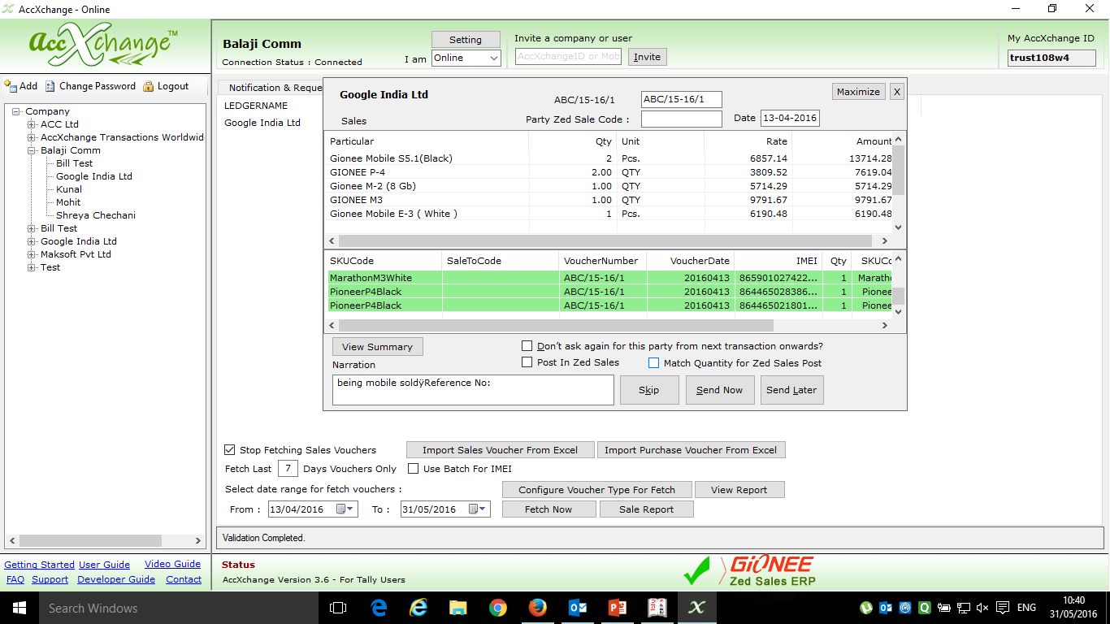
Choice to provide ZED SALES Code and automated mapping for next time

Slide 19
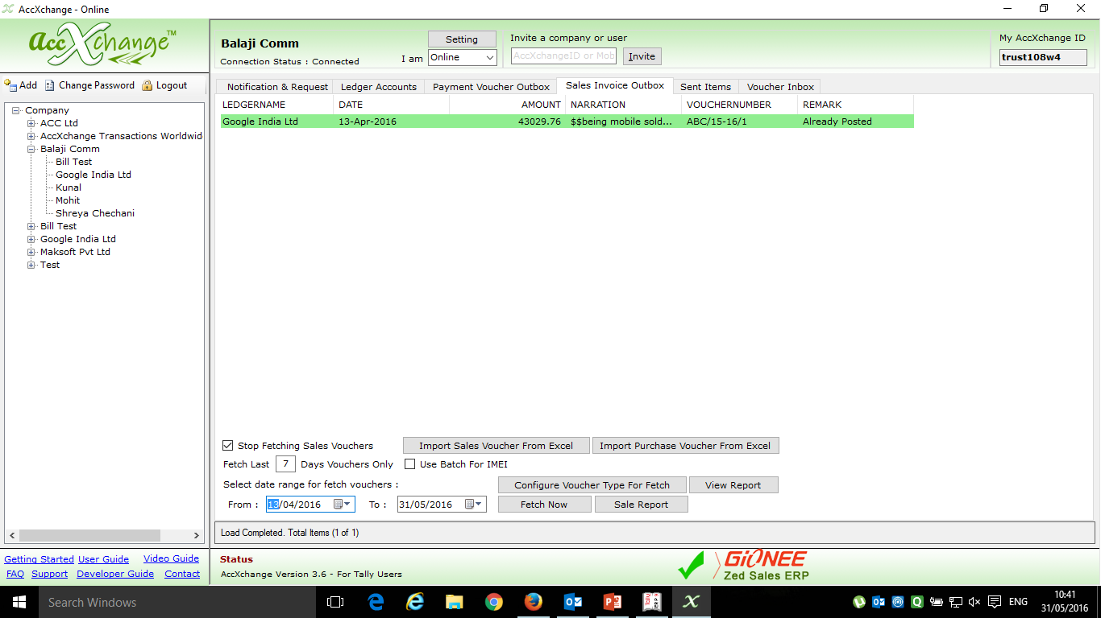
If the IMEI numbers are successfully updated in Zed Sales CRM then the narration of Sales Invoice will contain this sign ‘$$’ in Tally
Sales Entry Updated in Zed Sales CRM is being Highlighted in green Colour and is Shown in Sales Invoice Outbox Tab

Slide 20
Screen Show Checking of Pending IMEI Numbers for the given period

Slide 21
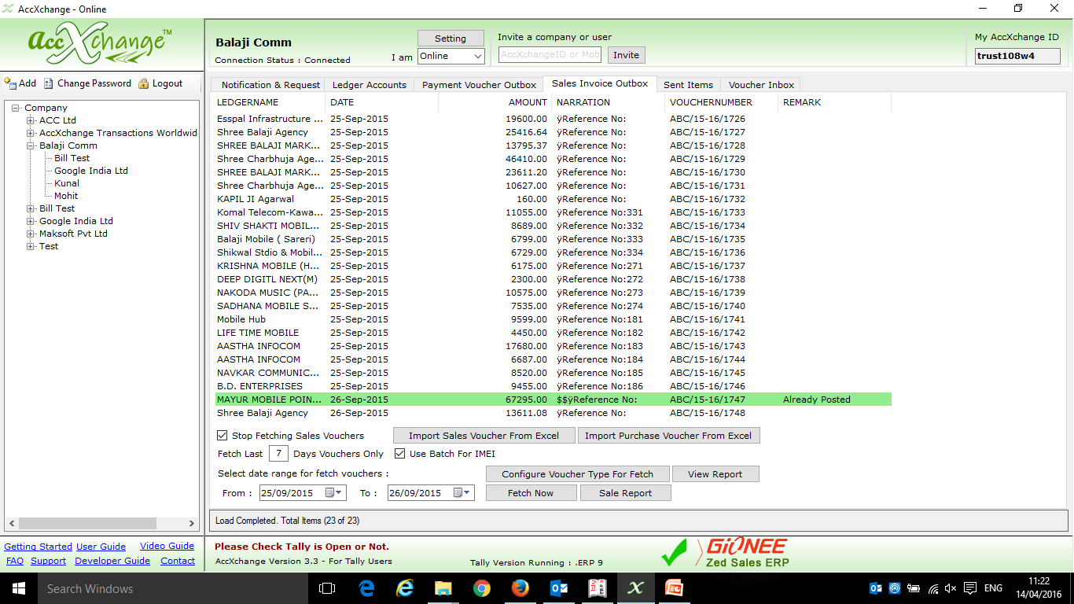
To check the IMEI of certain period, first fetch the voucher of that period from Tally in AccXchange in Sales Invoice Outbox Tab

Slide 22
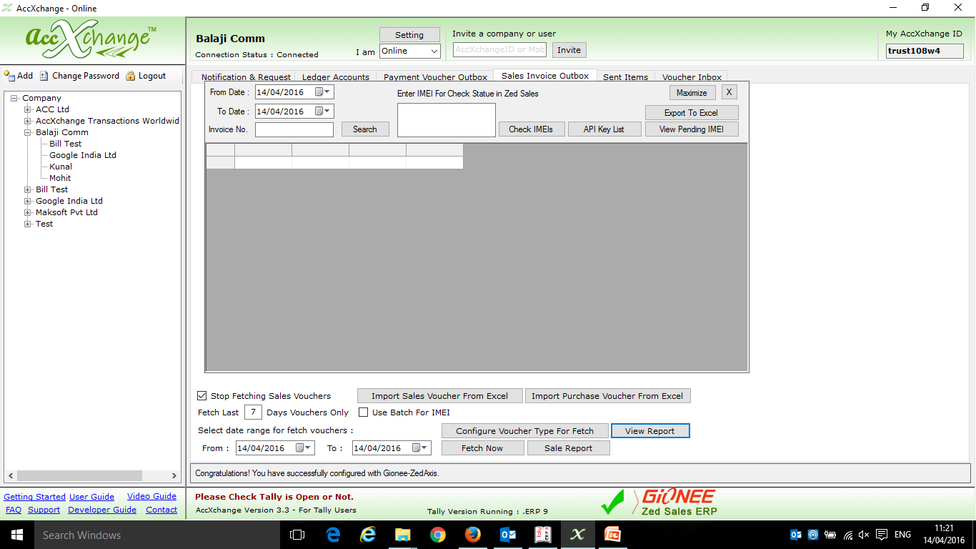
After the Vouchers are fetched then click on view report

Slide 23
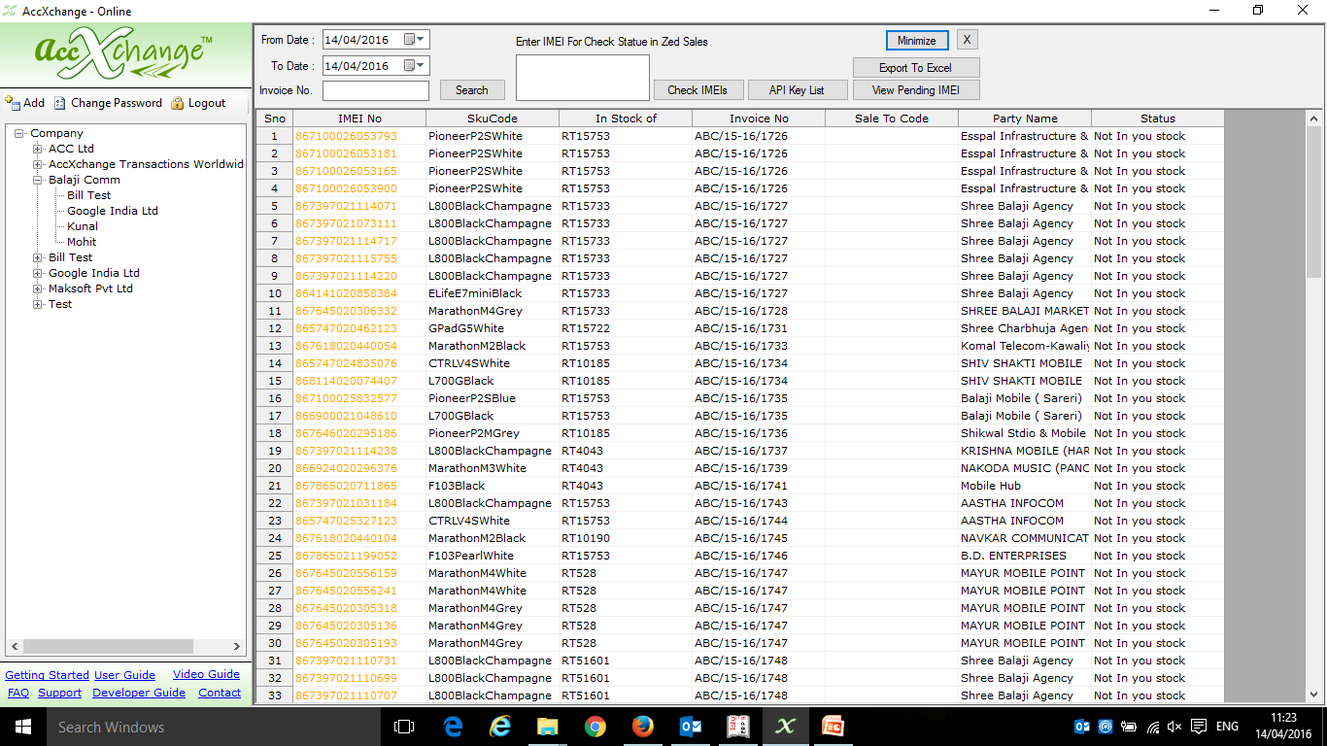
After that select the same period in view report tab and click on search to fetch all the IMEI that you have updated in Zed Sales during that period

Slide 24
Screen Show Sending Digital Invoice to Dealers/Retailers
Books of Balaji Comm
Assuming Supplier and Buyer is already connected

Slide 25
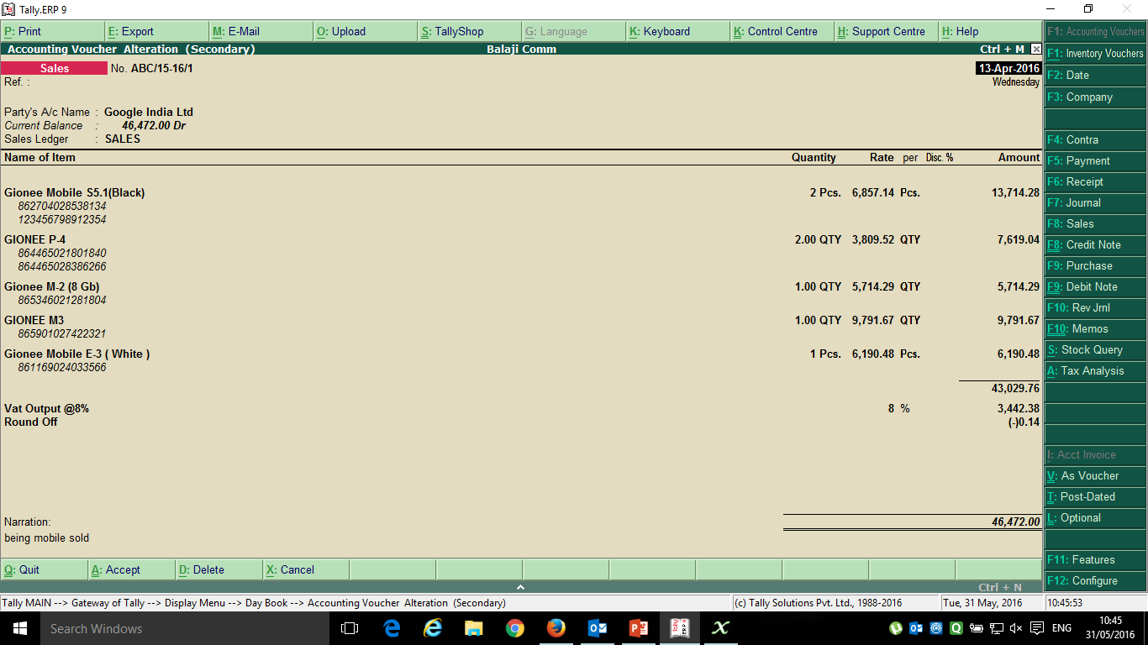
Created a Sales Invoice to sell different models Gionee Mobiles to Google India Ltd having different IMEI no

Slide 26
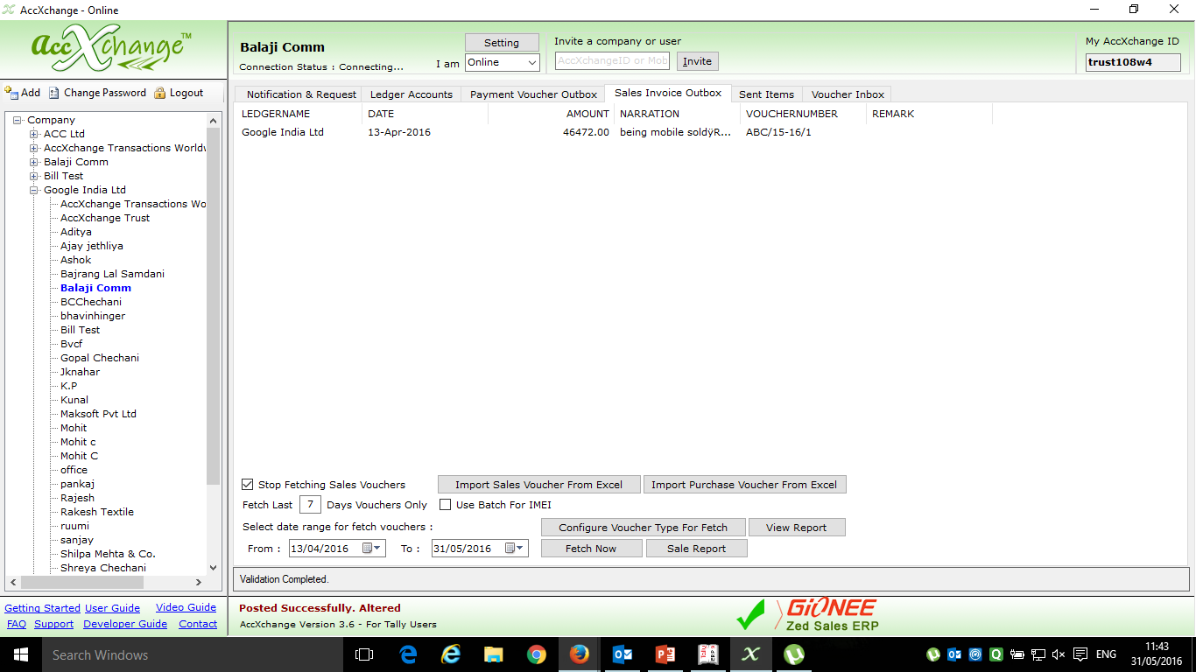
Sales Entry fetched in Sales Invoice Outbox Tab ready to be sent to Google India Ltd

Slide 27
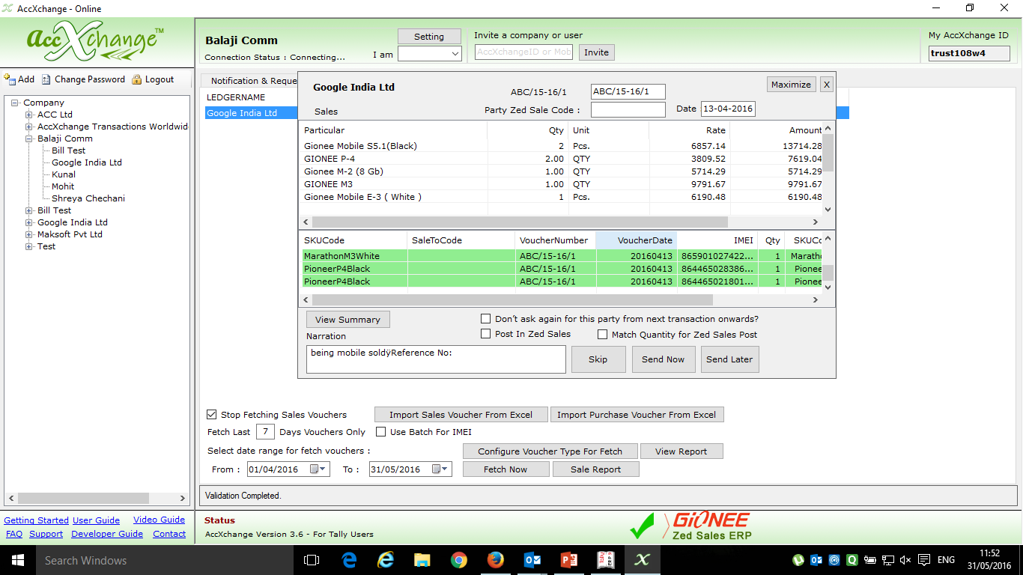
Verifying Sales Entry before the sending to Google India Ltd

Slide 28
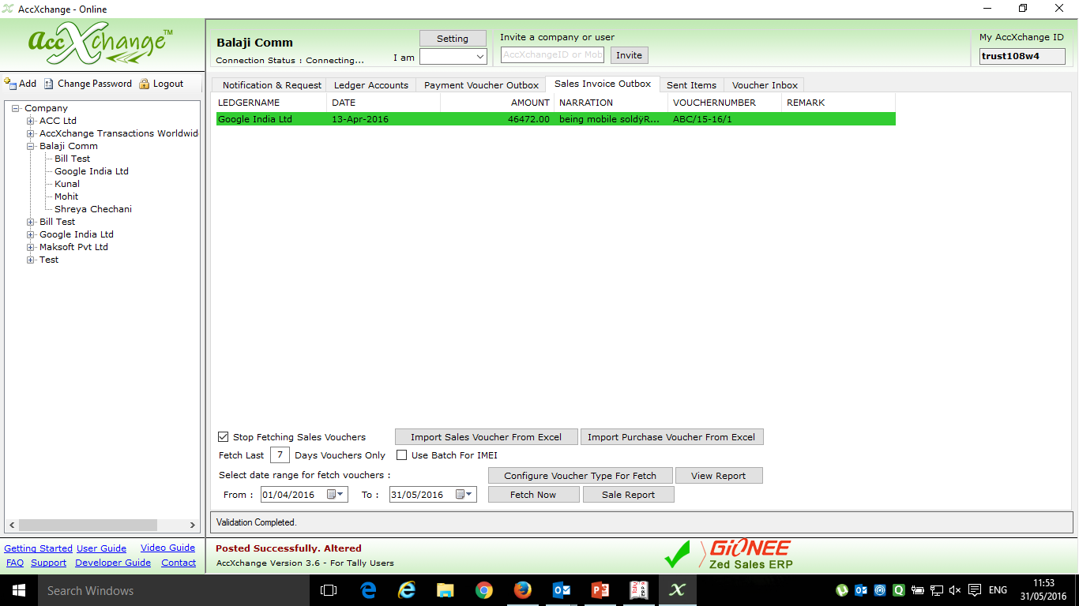
And if the Voucher is Sent to Google India ltd then narration will also contain this sign ‘***’ in Tally.
Sales Entry sent to Google India Ltd is being Highlighted in green Colour and is Shown in Sales Invoice Outbox Tab

Slide 29
Screen Show Posting of Incoming Digital Invoice from ND
Books of Google India Ltd
Assuming Supplier and Buyer is already connected

Slide 30
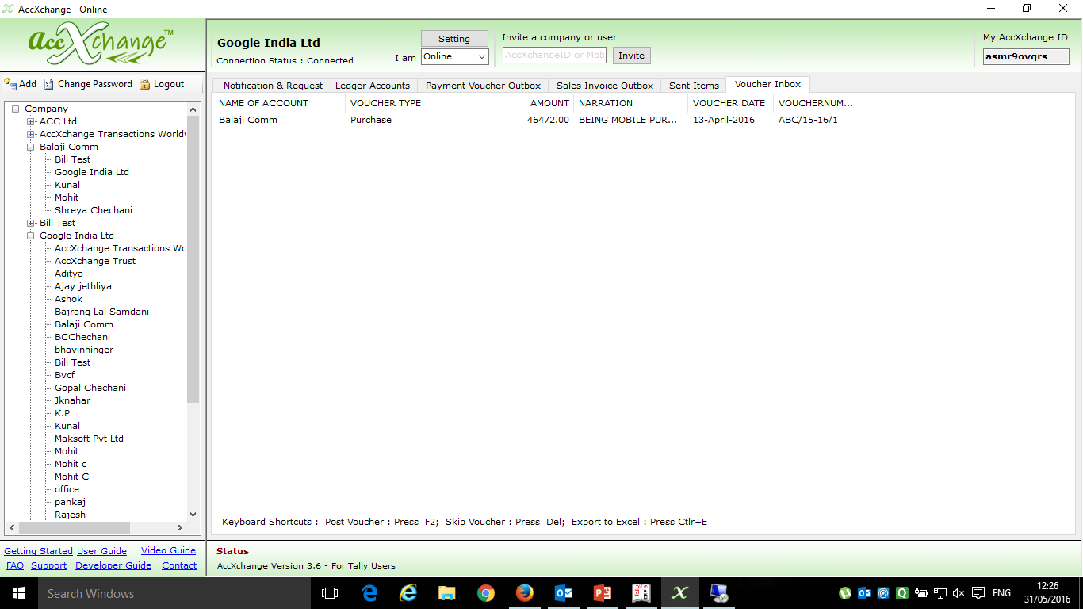
Sales Entry is received from Balaji Comm as Purchase Voucher in Google India Ltd in Voucher Inbox Tab

Slide 31
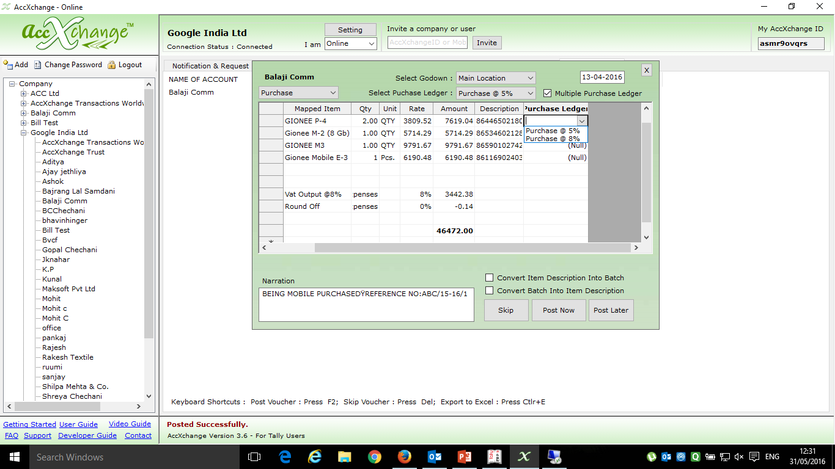
Selecting Item wise Purchase Ledger for user who maintain Item wise Purchase Ledger for Multi Taxation Purpose
Selecting Godown
Selecting Voucher Type Purchase or Purchase Order
Selecting Purchase Ledger if single Common Purchase Ledger is maintained
One time Mapping of Stock Items
One time of input VAT ledger
Converting IMEI from Description to Batch
Converting IMEI Batches to Description
Verifying Entry received from Balaji Comm before posting it in Tally in the books of Google India Ltd

Slide 32
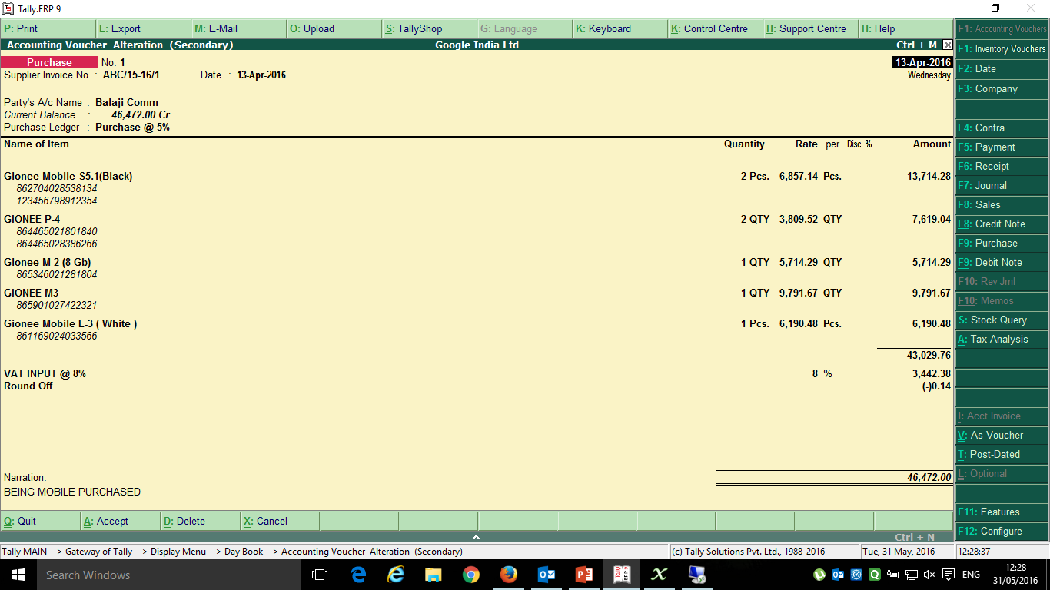
Purchase Entry Successfully Posted in Tally in the Books of Google India Ltd through AccXchange

Slide 33
Screen Show Sending of Digital Invoice from ND on Smart Phone
Books of Google India Ltd
Assuming Supplier and Buyer is already connected through Mobile App

Slide 34
Sales Invoice to sell different models of Gionee to Google India Ltd having different IMEI no

Slide 35
Sales Entry fetched in Sales Invoice Outbox Tab ready to be sent to Google India Ltd

Slide 36
Verifying Sales Entry before the sending to Google India Ltd

Slide 37
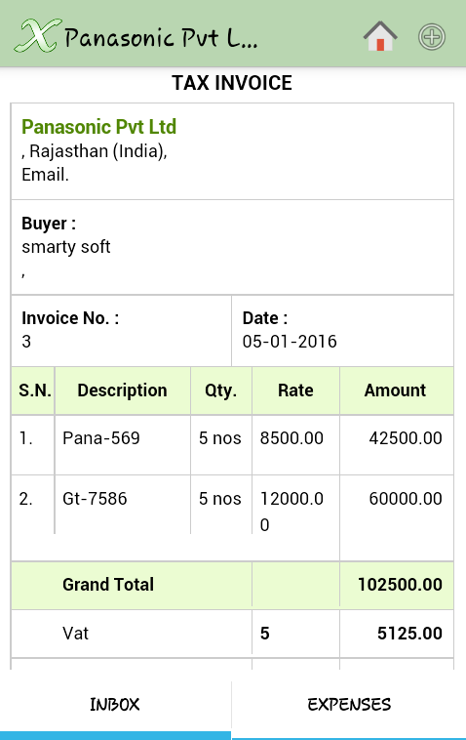
Receive Invoice Digitally on Smartphone.

Slide 38
Thank You
Gopal Chechani
AccXchange Transactions Worldwide Pvt Ltd
Gopal.Chechani@accxchange.in, www.AccXchange.in
Mobile: +91-8875627160

