Slide 1
Introducing….
Mobile IMEI Update Solution
From Tally to Zed Sales- Bill by Bill
for GIONEE National Distributors

Slide 2
Solutions Offering
Real-time Mobile IMEI update to Zed Sales
Digital Invoice to RDs for Automated Posting into Tally
Instant Access to Statement of Account with all RDs
Invoice to RDs in HTML format on their Smart Phone
Billing Add-on for scaning Mobile IMEI from large boxes

Slide 3
Pain Areas and Challenges with Manual update of Mobile IMEI with Zed Sales
Preparing Excel Sheet with accurate information takes time.
On mismatch of certain IMEI, Zed Sales does not allow to upload
Requires editing multiple time before successful upload to zed Sales
Model no for every Mobile IMEI is not available handy
Physical despatch of goods but sales being not updated in Zed Sales

Slide 4
Real-time Mobile IMEI update to Zed Sales
Bill by Bill updating of IMEI No. to Zed Sales.
SKU code of Model no is directly fetched from Zed sales from IMEI No.
Report for the pending IMEI No. for the invoices created during the given period of time.
Updating of IMEI No. in Zed Sales for both Sales & Sales return transactions.
View status of Specific IMEI No. or multiple IMEI No.
Check the IMEI No. is in stock of which Distributor/Retailer.
Benefits
No more creation of Excel Sheets for updating of IMEI no in Zed Sales.
No need to remember SKU code of specific Model.
Ensure timely, accurate and simplified Gionee Mobile IMEI No. into Zed Sales.

Slide 5
National Distributors
Sales to Distributors with IMEI Numbers
Upload Sales of Mobiles
with IMEI numbers
Distributors
One Click Report Secondary Sales with IMEI numbers
Transmit Invoice Digitally
Post of Invoices with IMEI Numbers
One Click Report of Tertiary Sales with IMEI numbers
Sales to Dealer with IMEI Numbers
One Click update of IMEI numbers
Transmit Invoice Digitally
Dealers/Retailers
Post of Invoices with IMEI Numbers
Sales to End User with IMEI Numbers

Slide 6
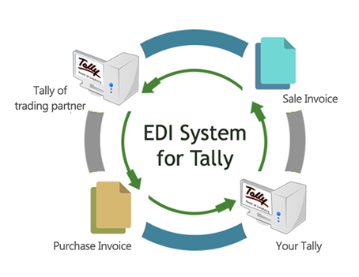
Digital Invoicing Solution for
Sending and Receiving invoices in digital format enabling automated entry in Tally of Recover’s company

Slide 7
Share and Access Ledger Accounts From One Tally Company to Another
Easily request for Statement of Accounts from your Connected Parties
Permission based request system, so no unauthorised invoice will be sent.
Export to excel for easy reconciliation
Benefits
Easily reconcile your ledgers as per the statement of Accounts.
Faster reconciliation leads to faster receipts of payments.
No need to be dependent on Accountant for access to Statements.

Slide 8
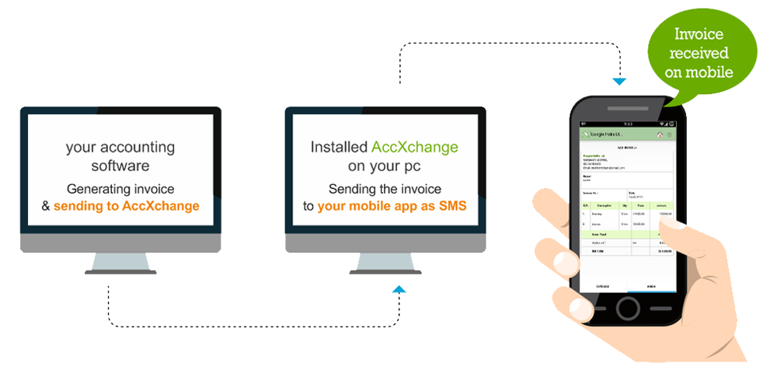
Notify Invoice to Customer's Smart Phone
Send invoices in Tally to your customer’s smart phone instantly.
Customers requires AccXchange App and connected to vendors AccXchange
Customers can get invoices from their other vendors through the same App.

Slide 9
Quick look at How the IMEI Numbers will be updated in Zed Sales CRM
Books of Balaji Comm

Slide 10
You don’t have to change the way you create Sales Invoice in your books
Just Create a Sales Invoice with Following details
Party Name.
Mobile Model No. Sold.
IMEI no of Mobiles in either Description or in Batches.
Inputting Other charges and appropriate Taxes.

Slide 11
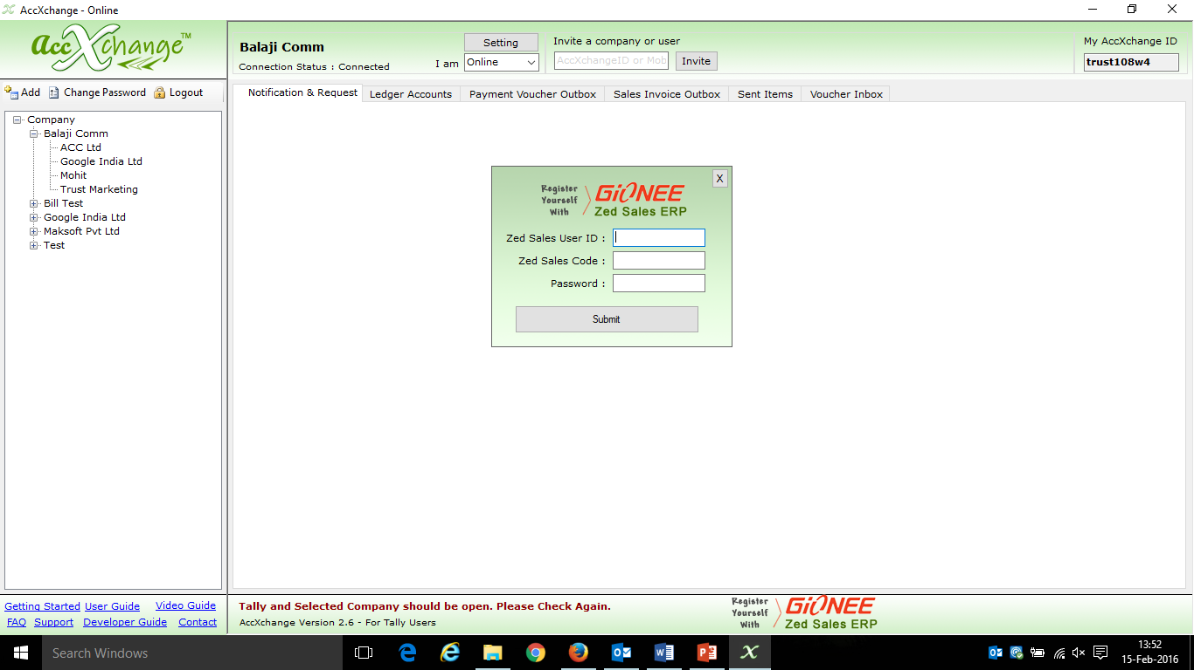
One Time Registration with Zed Sales User Id & Zed Sales Code(Distributor Code) to integrate with Tally for Direct updation of IMEI no. for every Mobile Brand a Distributor deal with

Slide 12
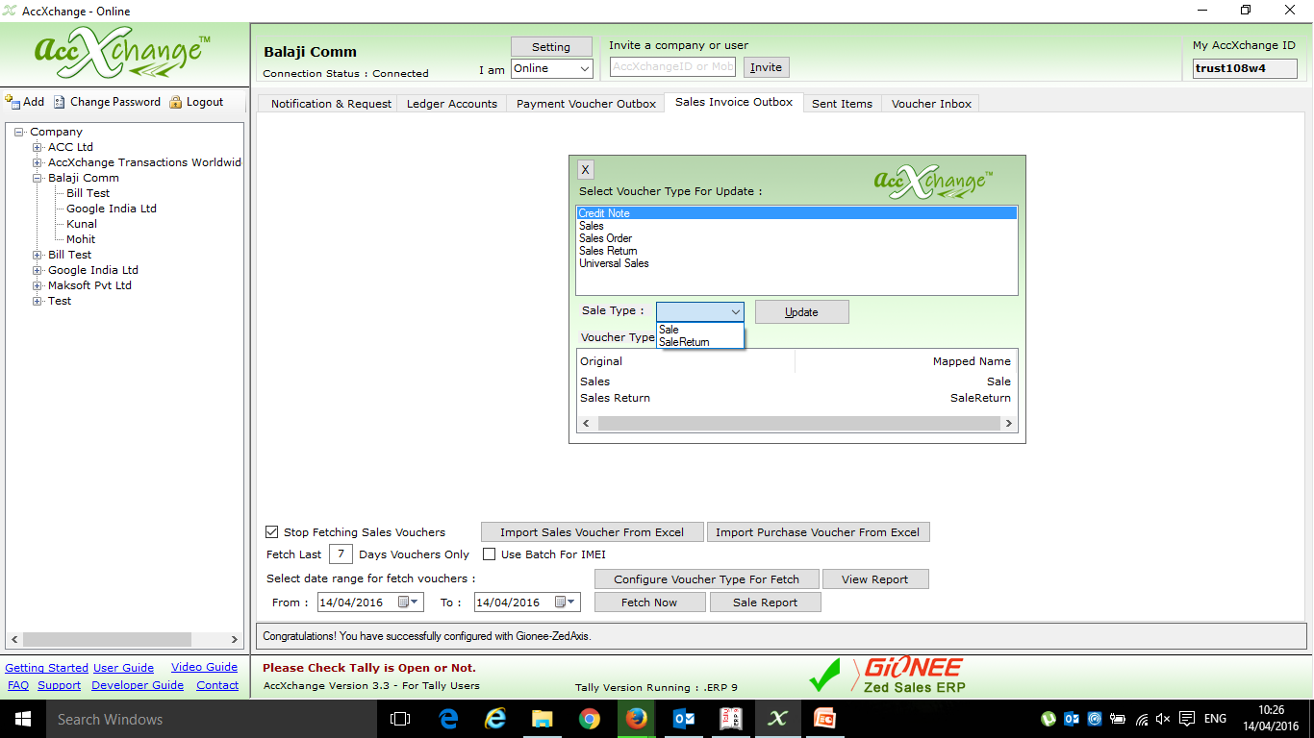
Configuring Voucher types for easy Updation of Sales & Sales Return in Zed Sales CRM for every Mobile Brand a Distributor deal with

Slide 13
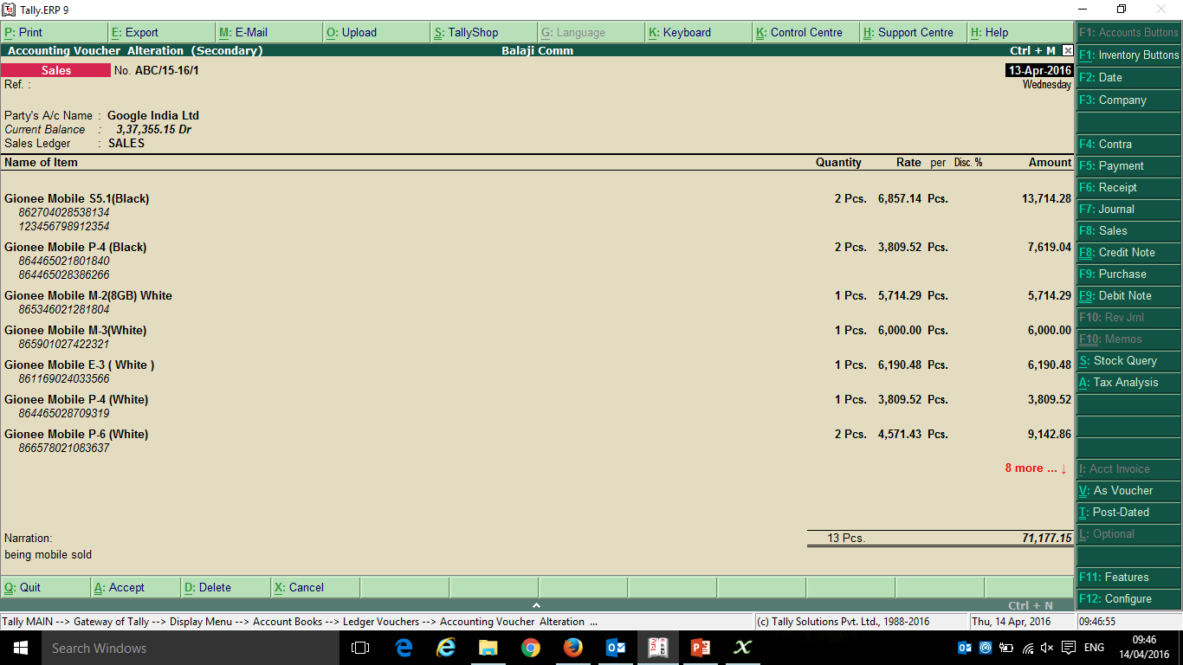
Created a Sales Invoice to sell different models Gionee Mobiles to Google India Ltd having different IMEI no

Slide 14
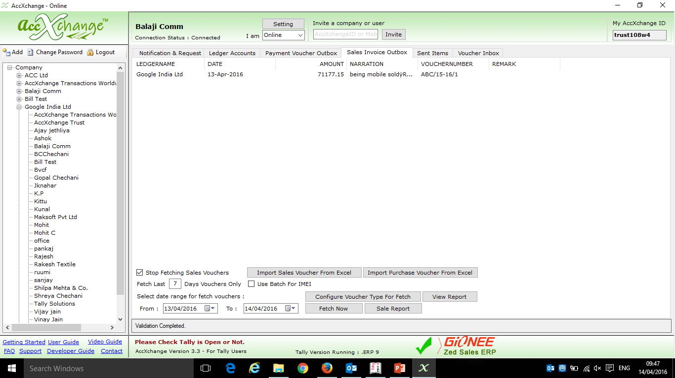
Sales Entry fetched in Sales Invoice Outbox Tab ready to be updated in Zed Sales CRM

Slide 15
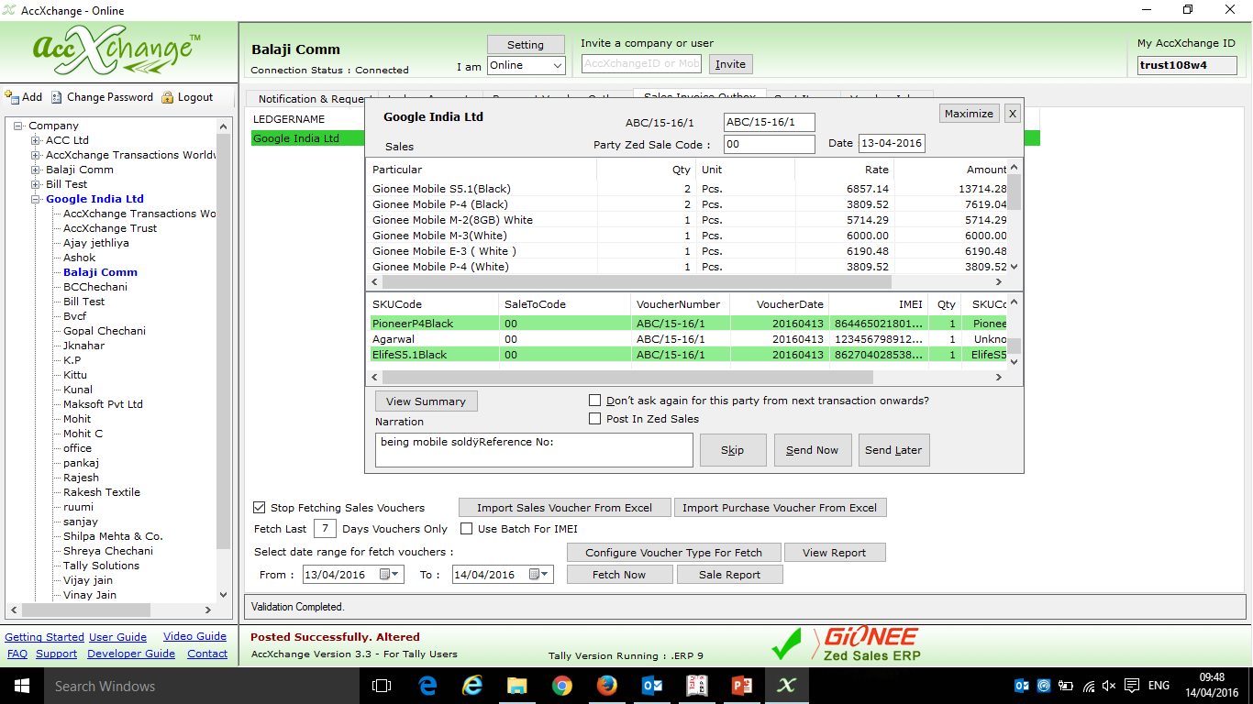
The IMEI no Highlighted in Green are updated in Zed Sales CRM as they are of Gionee Mobile,
The IMEI numbers not Highlighted are of other Mobile Company or are wrong.
Verifying Sales Entry before the updation of IMEI no in Zed Sales CRM

Slide 16
Option to edit Bill no in case of Duplicate invoice No
Party Zed sales code to whom the Mobiles are sold
Tick this and Click on Send now to update the IMEI no in ZED sales CRM
Code of party who sold Mobile
Voucher No
Voucher Date
Quantity
SKU Code
IMEI No.

Slide 17
Choice to provide ZED SALES Code and automated mapping for next time

Slide 18
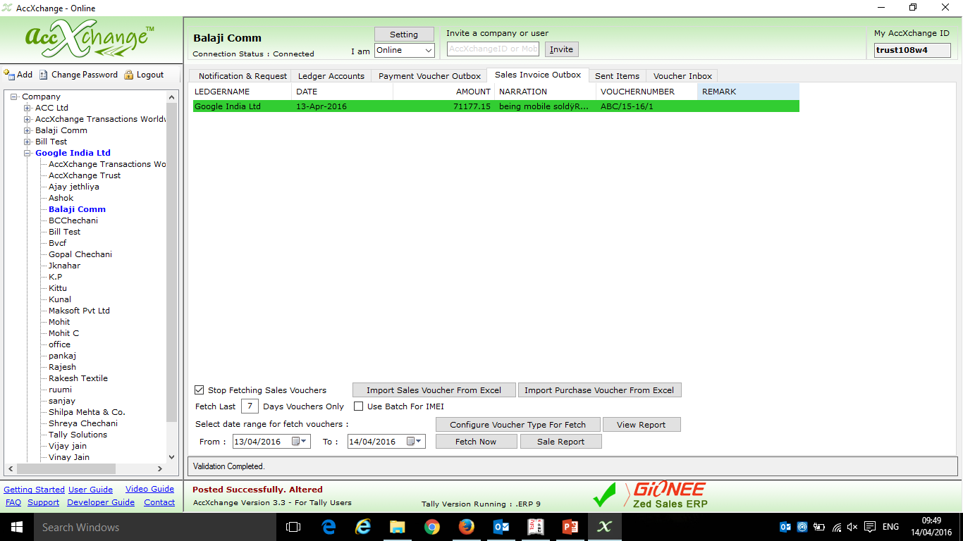
If the IMEI numbers are successfully updated in Zed Sales CRM then the narration of Sales Invoice will contain this sign ‘$$’ in Tally
Sales Entry Updated in Zed Sales CRM is being Highlighted in green Colour and is Shown in Sales Invoice Outbox Tab

Slide 19
Quick look at
How the National Distributor can check the status of Pending IMEI for the given period of time

Slide 20
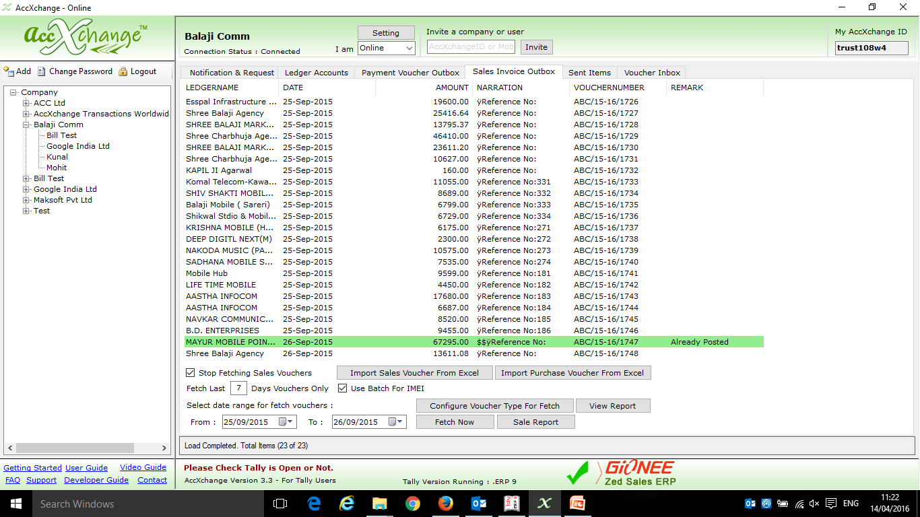
To check the IMEI of certain period, first fetch the voucher of that period from Tally in AccXchange in Sales Invoice Outbox Tab

Slide 21
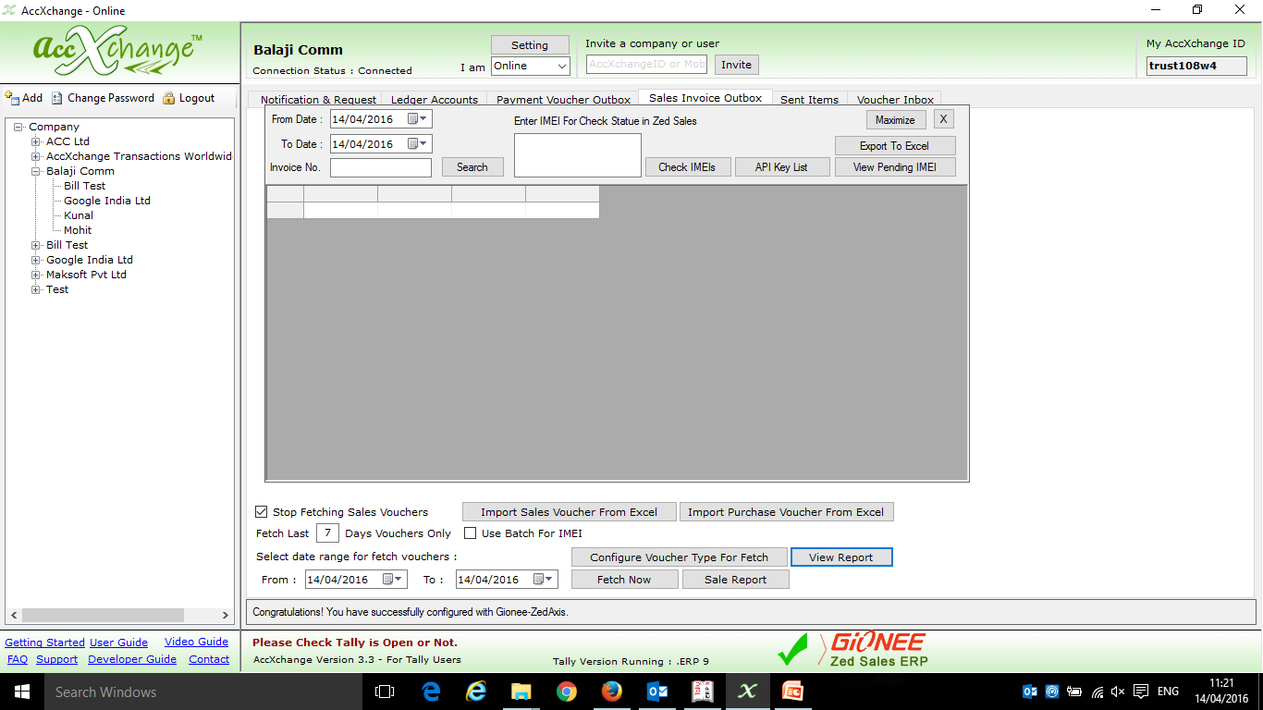
After the Vouchers are fetched then click on view report

Slide 22
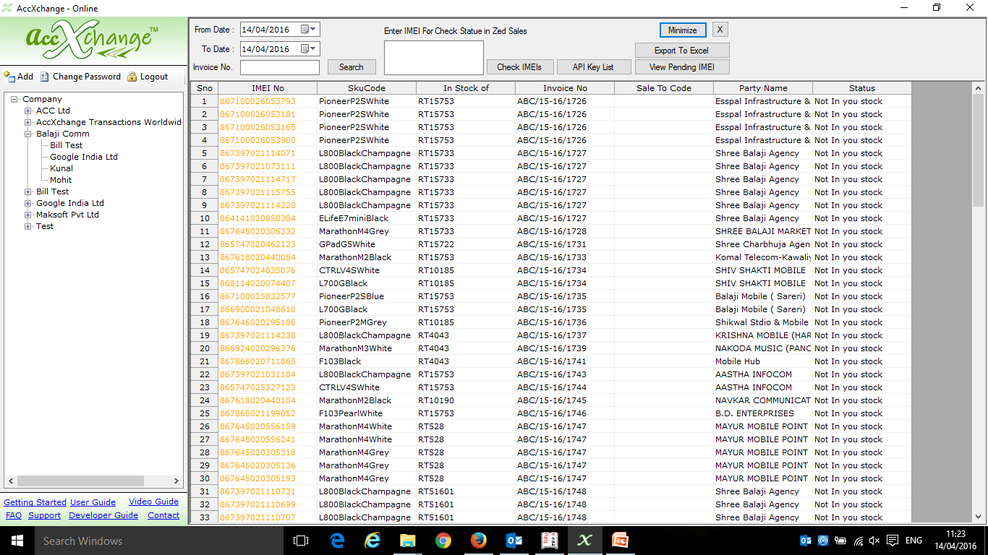
After that select the same period in view report tab and click on search to fetch all the IMEI that you have updated in Zed Sales during that period

Slide 23
Quick look at How the Bulk IMEI Scanning and Validation for Tally Invoices works
Books of ACC Ltd

Slide 24
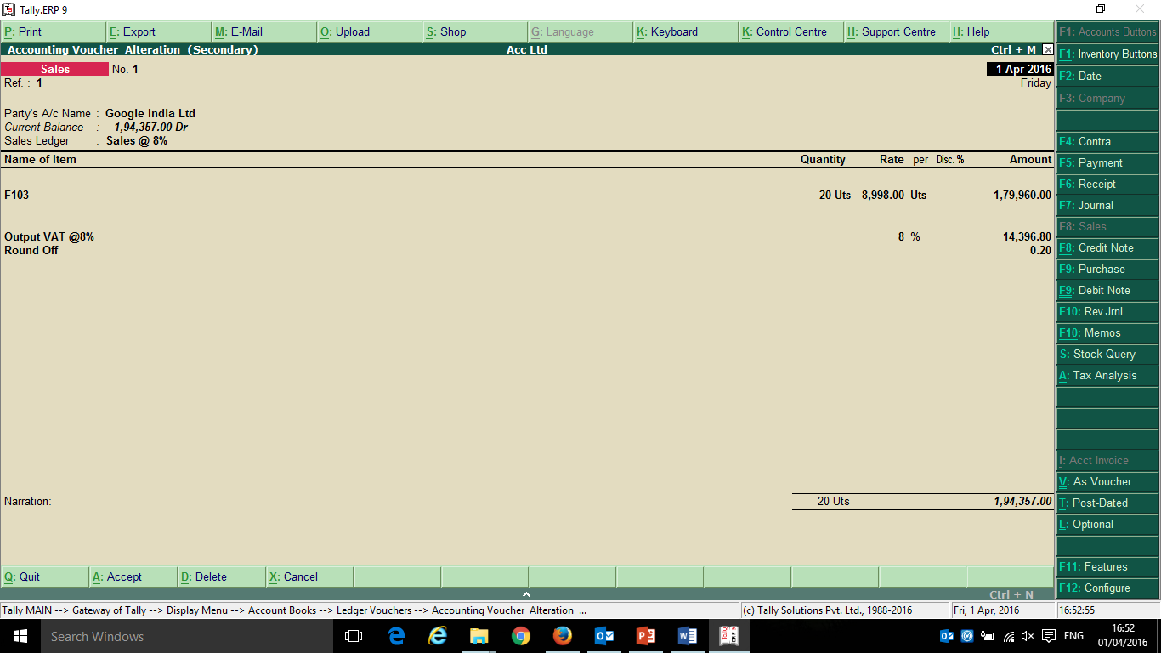
Sales Department Creates Sales Invoice in the Books without entering the IMEI no. of the Mobile in Description

Slide 25
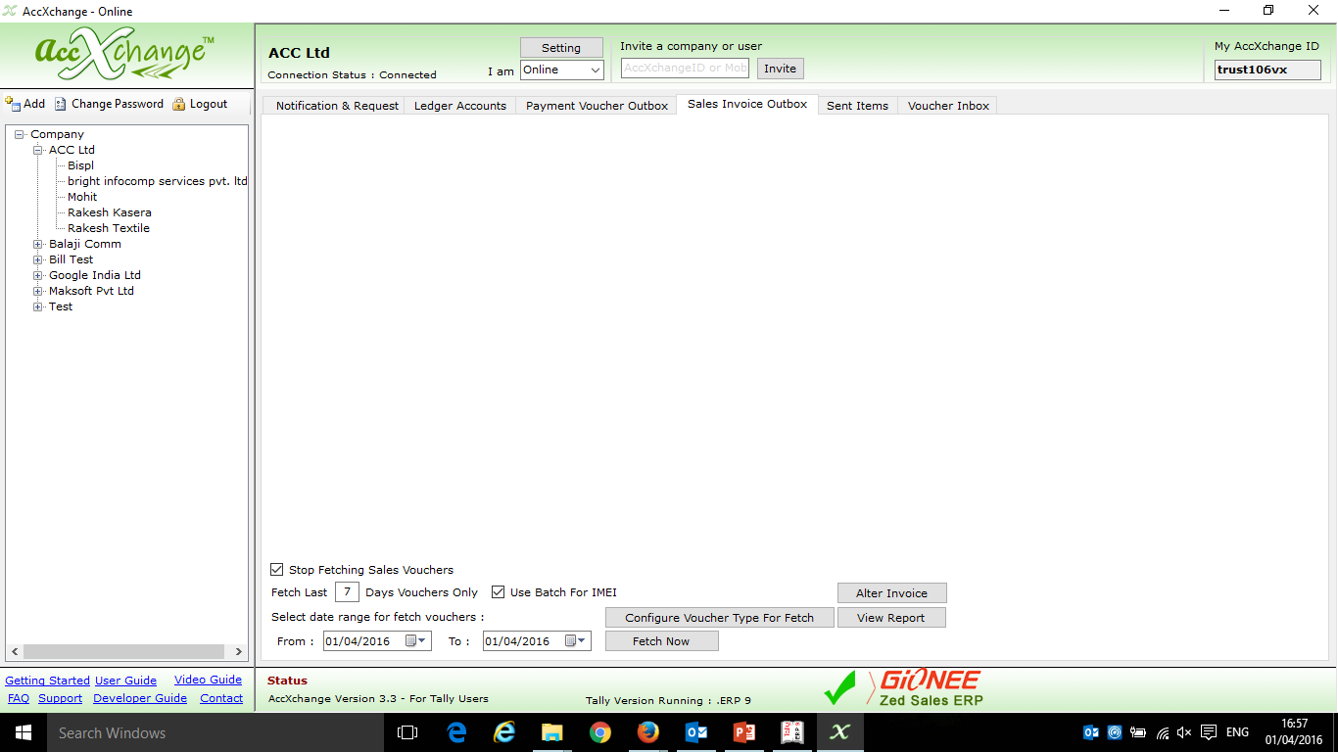
Then Dispatch department opens AccXchange and Clicks on ‘Alter Invoice’ to add the IMEI no in the Invoice

Slide 26
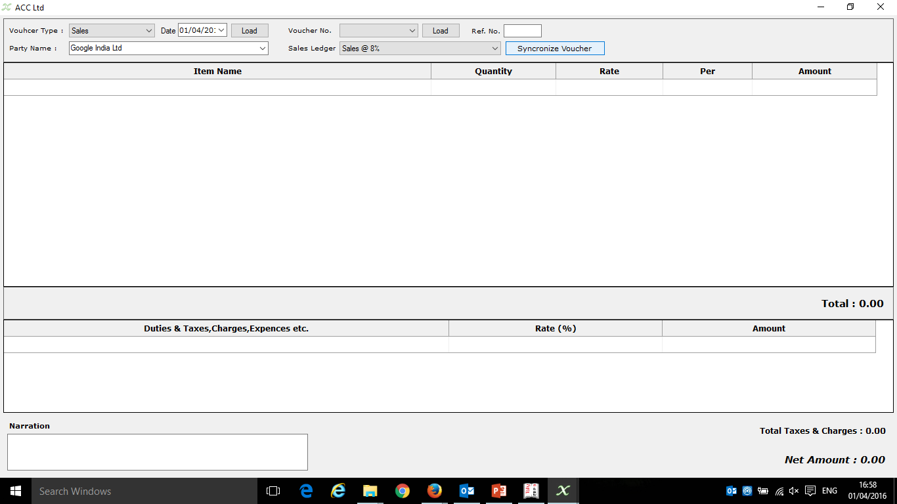
Then Dispatch department user will have to Synchronize the Invoices, to do so click on ‘Synchronize Vouchers’

Slide 27
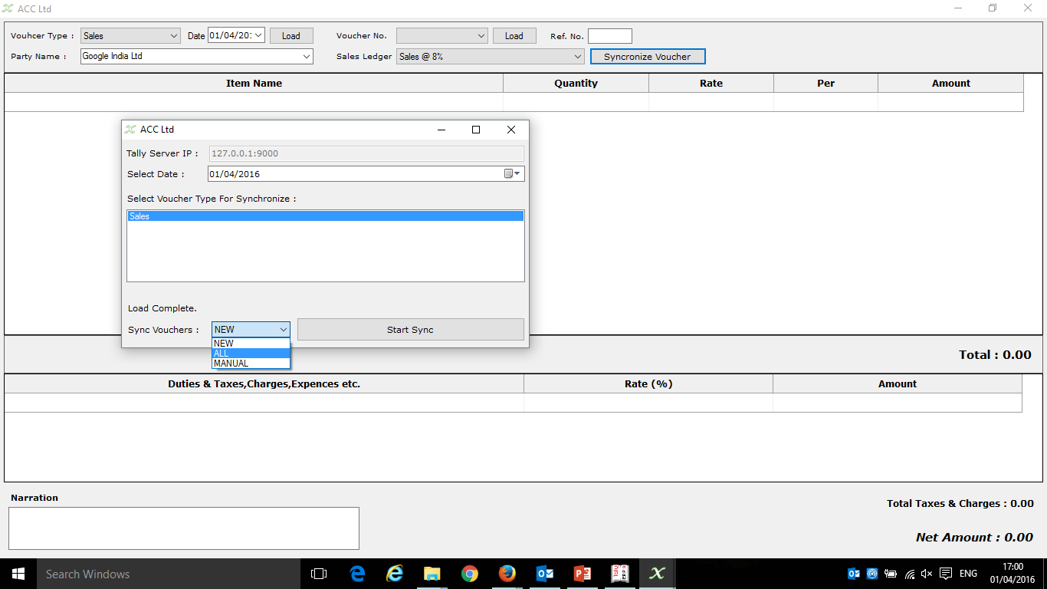
Then select the date of which vouchers are to be synchronized, and also whether to sync all Vouchers, New Vouchers or Select Vouchers manually.
Then Click on ‘Start Sync’

Slide 28
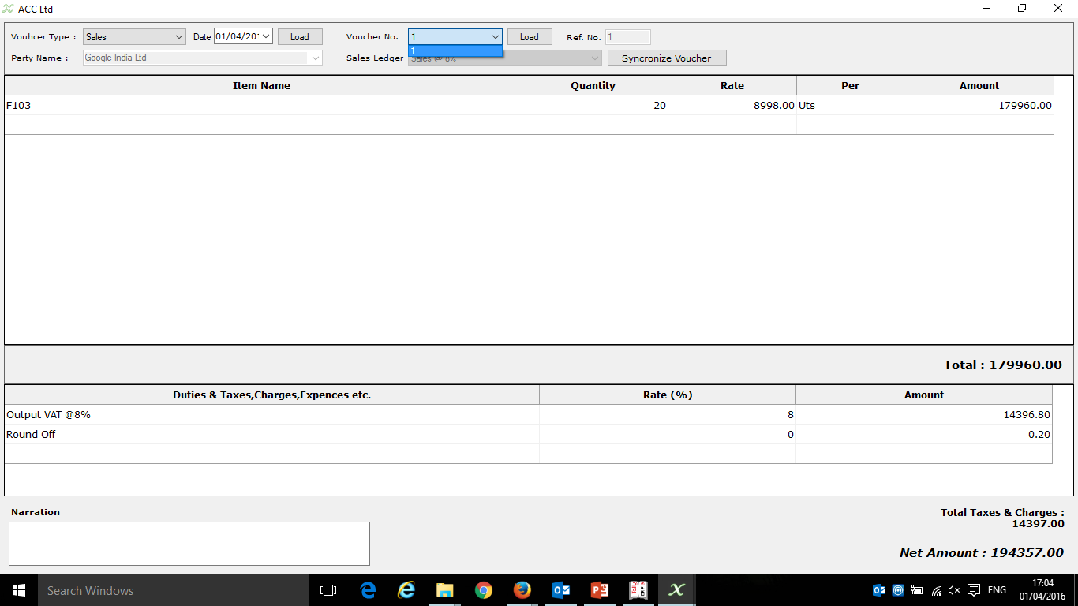
Then Select the Voucher No and Click on Load to enter the IMEI no in Description

Slide 29
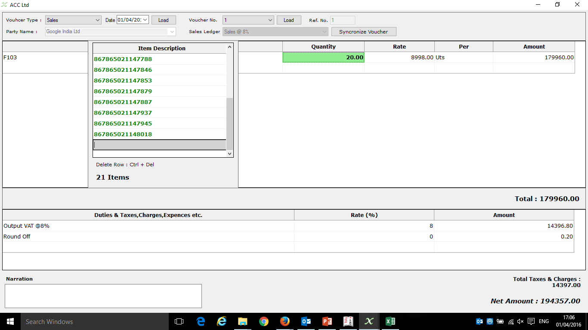
Then Enter the Box no of the Mobile to Input all the 20 IMEI at Once in the description
or
Scan IMEI one by One with help of barcode reader

Slide 30
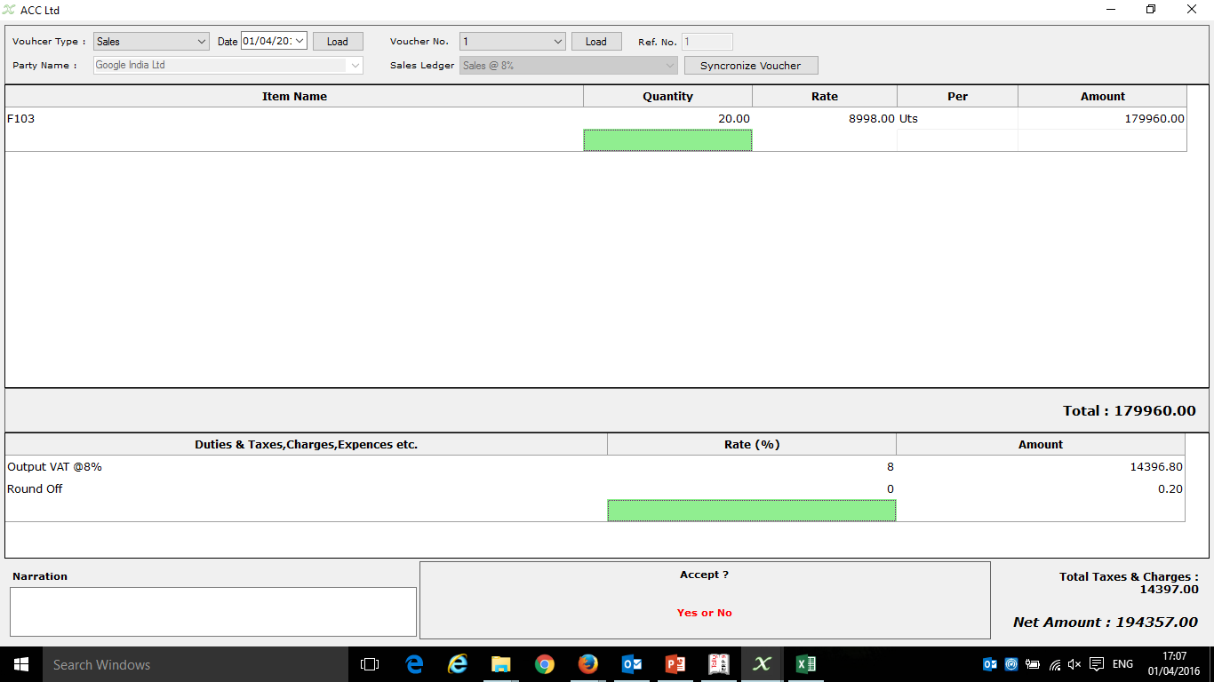
Then Press enter to Save the Voucher with IMEI no in description.

Slide 31
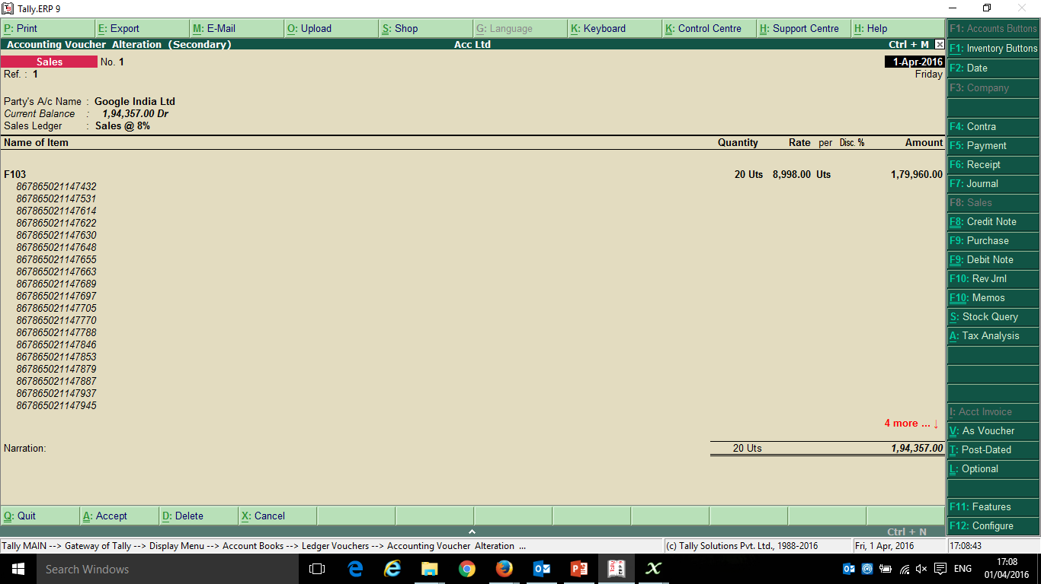
Then Open Tally and check the IMEI no added in Description

Slide 32
Key Value Drivers of AccXchange
Simplifies Zed Sales Portal Update
Enables Collaborative Accounting
Lowers down cost of managing Accounts & Inventory
Improving Speed of information and data exchange
Accuracy in information capturing – Less Human Errors

Slide 33
Thank You
AccXchange Transactions Worldwide Pvt Ltd
21, Badal Textile Market, Pur Road, Bhilwara-311001 Rajasthan
ca.bc.chechani@accxchange.in , www.AccXchange.in
Mobile: +91-8875627151: Boardline : +91-7822094210

